Slide 1

Introduction to RINEX,
GPS Raw Data
Geodetic Survey Section
Miss CHAN Wing-yee
21 June 2006

Slide 2
RINEX
Receiver Independent Exchange Format
Developed by the Astronomical Institute of the University of Berne in 1989
For the easy exchange of the GPS data to be collected
For processing in various software
Version 2.10 used in SatRef System

Slide 3
RINEX
Consists of 3 ASCII file types available to be downloaded from SatRef System
File Type | Containing Information
Observation Data File | GPS Measurements
GPS Navigation Message File | Ephemeris (Orbit information)
Meteorological Data File | Pressure, Temperature, Relative Humidity, etc

Slide 4
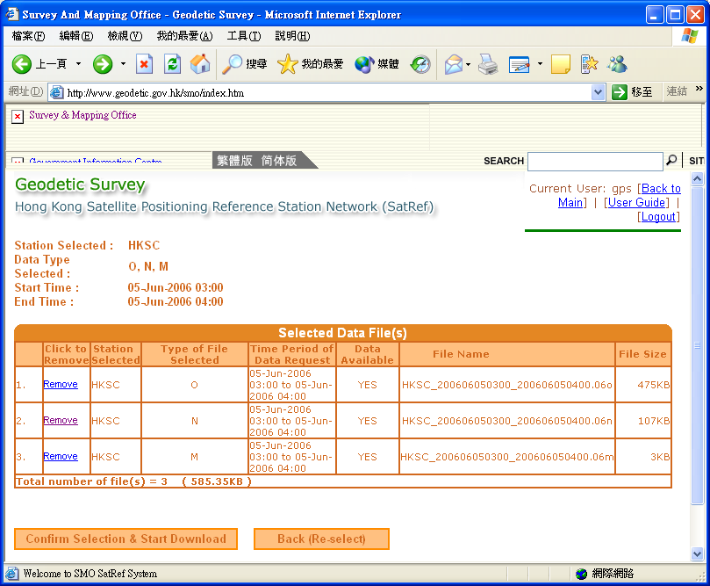
RINEX

Slide 5
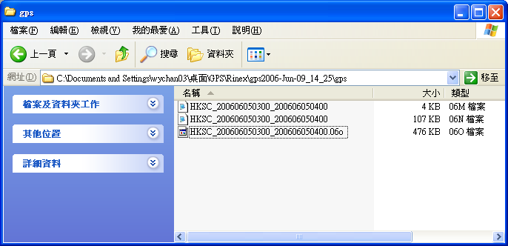
RINEX
M: Meteorological
Data File
N: Navigation File
O: Observation File
RINEX Data of the station HKSC on 5 June 2006 from UTC Time 3:00 to 4:00

Slide 6
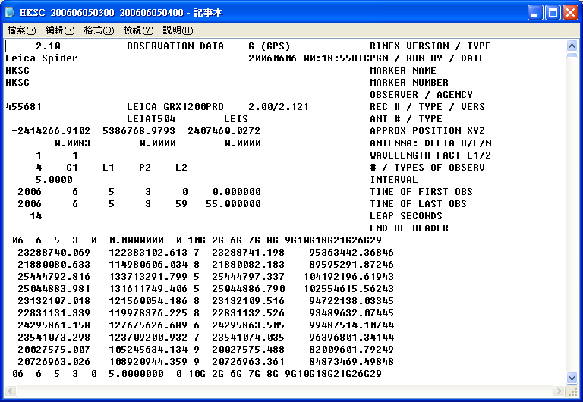
Observation File
Header
Section
Data
Section
Observation File of HKSC on 5 June 2006 from UTC Time 3:00 to 4:00

Slide 7
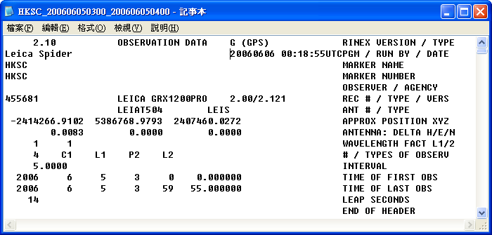
Observation File: Header Section
C1 : Pseudorange using C/A code on L1
L1 : Phase measurements on L1
P2 : Pseudorange using P-Code on L2
L2 : Phase measurements on L2
PGM/ RUN BY / DATE Program, Agency, date of creating the file
REC # / TYPE / VERS Receiver Number, type, version
ANT # / TYPE Antenna Number, TYPE
APPROX POSITION XYZ Approximation marker position (in WGS84)
ANTENNA: DELTA H/E/N Antenna height, Eccentricities of antenna centre
relative to marker in east and north (in metres)
WAVELENGTH FACT L1/2 Wavelength factors for L1 and L2
# / TYPES OF OBSERV Number of observation types, observation types
TIME OF FIRST OBS Time of first observation record

Slide 8
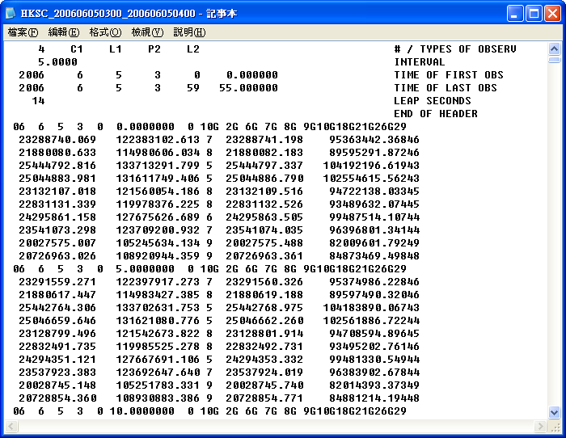
Observation File: Data Section
Observation File of HKSC on 5 June 2006 from UTC Time 3:00 to 4:00

Slide 9
Observation File: Data Section
Number of Satellites
Event Flag
Epoch
Satellite Number
Observation File of HKSC on 5 June 2006 from UTC Time 3:00 to 4:00

Slide 10
Observation File: Data Section
Observation data
for each Satellite
Observation File of HKSC on 5 June 2006 from UTC Time 3:00 to 4:00

Slide 11
Observation File: Data Section
Observation data
for each Satellite
Observation File of HKSC on 5 June 2006 from UTC Time 3:00 to 4:00

Slide 12
Observation File: Data Section
Extracted observation data for GPS Satellite No. 2 at 3:00 on 5 June 2006:
C1
L1
P2
L2
23288740.069 122383102.613 7 23288741.198 95363442.36846
LLI
Signal
Strength
LLI
Signal
Strength
LLI (Loss of Lock Indicator)
0: OK
1: Cycle Slip
4: Antispoofing
Blank: not known
Signal Strength
Interval 1-9
1: minimum possible signal strength
9: maximum possible signal strength
0 or blank: not known

Slide 13
Navigation File
Data computed for Satellite Position
Satellite Motion is described by Satellite Orbit
Satellite Orbit is described by 6 (Keplerian) Elements

Slide 14
Navigation File: Satellite Orbit
Define satellite position in the satellite orbit - v
Define size and shape of the satellite orbit - a, e
Define the orientation of the satellite orbit - ω
Define the orbital plane in the equatorial system - Ω, I
v | True Anomaly
a | Semi-major axis of ellipse
E | Eccentricity
I | Inclination of the orbit
Ω | Right ascension of the ascending node
ω | Argument of perigee

Slide 15
Navigation File: Satellite Orbit
e
Satellite
r
earth
a
ν
Apogee
Perigee
position vector, r
focus
Satellite Position
true anomaly, ν
semi-major axis, a : Size of Orbit
eccentricity, e : Shape of Orbit

Slide 16
Navigation File: Satellite Position
argument of perigee, ω :
orientation of orbit
Z
right ascension of the
ascending node, Ω
inclination, i
orbital plane
in equatorial
system
Satellite
Perigee
r
ν
Equatorial plane
ω
Ω
X
i
Y
Ascending node

Slide 17
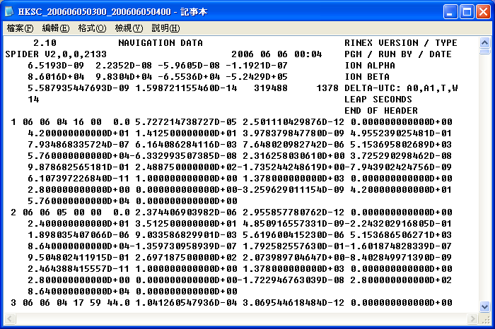
Navigation File
Navigation File of HKSC on 5 June 2006 from UTC Time 3:00 to 4:00

Slide 18
Navigation File: Data section
Satellite Number Epoch ao a1 a2
IOD Crs Δn Mo t0e
Cus e Cus √ a
t0e Cic Ω Cis
I Crc ω Ω dot
I dot L2 GPS Week L2 P code
Satellite accuracy Satellite health TGD IODC
Transmission Time Spare
Mo t0e: Mean Anomaly
- Mathematical Abstraction of True Anomaly v

Slide 19
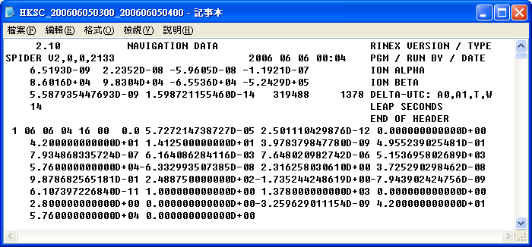
Navigation File: Data Section
e
Ω
v (mean)
√a
i
ω
Navigation File of HKSC on 5 June 2006 from UTC Time 3:00 to 4:00

Slide 20
Reference
PowerPoint - RINEX Computation by CW Lau
http://gps.wva.net/html.common/rinex.html
The RINEX Format: Current Status, Future Developments by Werner Gurtner and Gerald M.Mader
Space and Physical Geodesy by H.Bâki lz
GPS Theory and Practice by B.Hofmann et al

